Slide 1

Sustainable
Development
Goals (SDGs)
ALSÓMOCSOLÁD MEETING
CERV AXA PROJECT
23-25 APRIL 2026

Slide 2
The 2030 Agenda at a Glance
Bridging the Gap in 2026
The Vision: 17 Goals adopted by all UN Member States in 2015 to end poverty, protect the planet, and ensure peace and prosperity by 2030.
The Three Pillars:
  Social: Equity, health, and education.
  Economic: Sustainable growth and infrastructure.
  Environmental: Climate action and biodiversity.
Current Reality: As of 2026, only 15% of targets are on track. The "SDG Stimulus" is now critical to bridge the $4 trillion annual financing gap.

Slide 3


Slide 4
People (SDGs 1-5)
Leaving No One Behind
Goal 1 & 2 (Poverty & Hunger): Extreme poverty remains a challenge; over 700 million people still live on less than $2.15 a day. Food systems are being reimagined for resilience.
Goal 3 (Health): Maternal and child mortality rates have dropped significantly since 2015, but global mental health and pandemic preparedness are the new 2026 priorities.
Goal 4 & 5 (Education & Gender): Education systems are shifting toward AI Literacy and vocational training. Gender equality remains the "greatest human rights challenge," with a focus on closing the digital gender divide.

Slide 5
Planet (SDGs 6, 12-15)
Urgency in the Anthropocene (age of human activity)
Goal 13 (Climate Action): 2024 was the hottest year on record. In 2026, the focus has shifted from "mitigation" to "radical adaptation" and loss-and-damage financing.
Goal 14 & 15 (Life Below Water/Land): The "30x30" initiative (protecting 30% of land and sea by 2030) is the primary metric for 2026.
Circular Economy: Goal 12 is driving new global regulations on plastic waste and sustainable supply chains.

Slide 6
Prosperity & Peace (SDGs 7-11, 16)
Sustainable Systems and Justice
Energy (SDG 7): Renewables are now the cheapest source of power in most of the world. The 2026 goal is universal electricity access for the 600 million still without it.
Decent Work (SDG 8): Adapting to the "Green Jobs" transition and the impact of automation on labor markets.
Peace & Institutions (SDG 16): With global displacement at record highs (over 120 million people), strengthening the rule of law and reducing conflict is the "enabler" for all other goals.

Slide 7
The "Six Transitions" (2026 Priority)
How We Accelerate the Final Five Years
The UN has identified six high-impact areas where concentrated effort can move the needle:
Food Systems: Moving from industrial to regenerative agriculture.
Energy Access: Transitioning to carbon-free grids.
Digital Connectivity: Closing the gap for the 2.6 billion people still offline.
Education: Transforming curricula for a changing climate and workforce.
Jobs & Social Protection: Universal basic services and safety nets.
Biodiversity & Nature: Integrating nature into national accounting.

Slide 8
Partnerships & The Way Forward (SDG 17)
Your Role in the Decade of Action
Global Cooperation: Revitalizing the multilateral system amidst geopolitical tensions.
Data Revolution: Using AI and satellite data to track progress in real-time.
Call to Action:
  Governments: Policy alignment and "Green Budgeting."
  Business: Moving from ESG (Environmental, Social, and Governance) reporting to Actual Impact.
  Individuals: Sustainable lifestyle choices and advocacy.
Final Thought: "The SDGs are not a 'nice to have.' They are the only roadmap for a habitable planet and a stable global economy."

Slide 9
The European Green Deal
The Blueprint for a Climate-Neutral Continent
Objective: To make Europe the first climate-neutral continent by 2050.
Key Legislation: The European Climate Law turns political commitment into a legal obligation.
Intermediate Target: Reduce net greenhouse gas emissions by at least 55% by 2030 (compared to 1990 levels).
Funding: Mobilizing at least €1 trillion in sustainable investments over the next decade via the Just Transition Mechanism.

Slide 10
The Circular Economy Action Plan
Moving Beyond the "Take-Make-Waste" Model
Focus Areas: Electronics and ICT, batteries, vehicles, packaging, plastics, textiles, and construction.
Right to Repair: New rules to make repairs easier and more appealing for consumers, extending product lifespans.
Waste Reduction: Halving municipal waste that is not recycled or reused by 2030.
Sustainable Product Policy: Ensuring products placed on the EU market are designed to be durable, reusable, and energy-efficient.

Slide 11
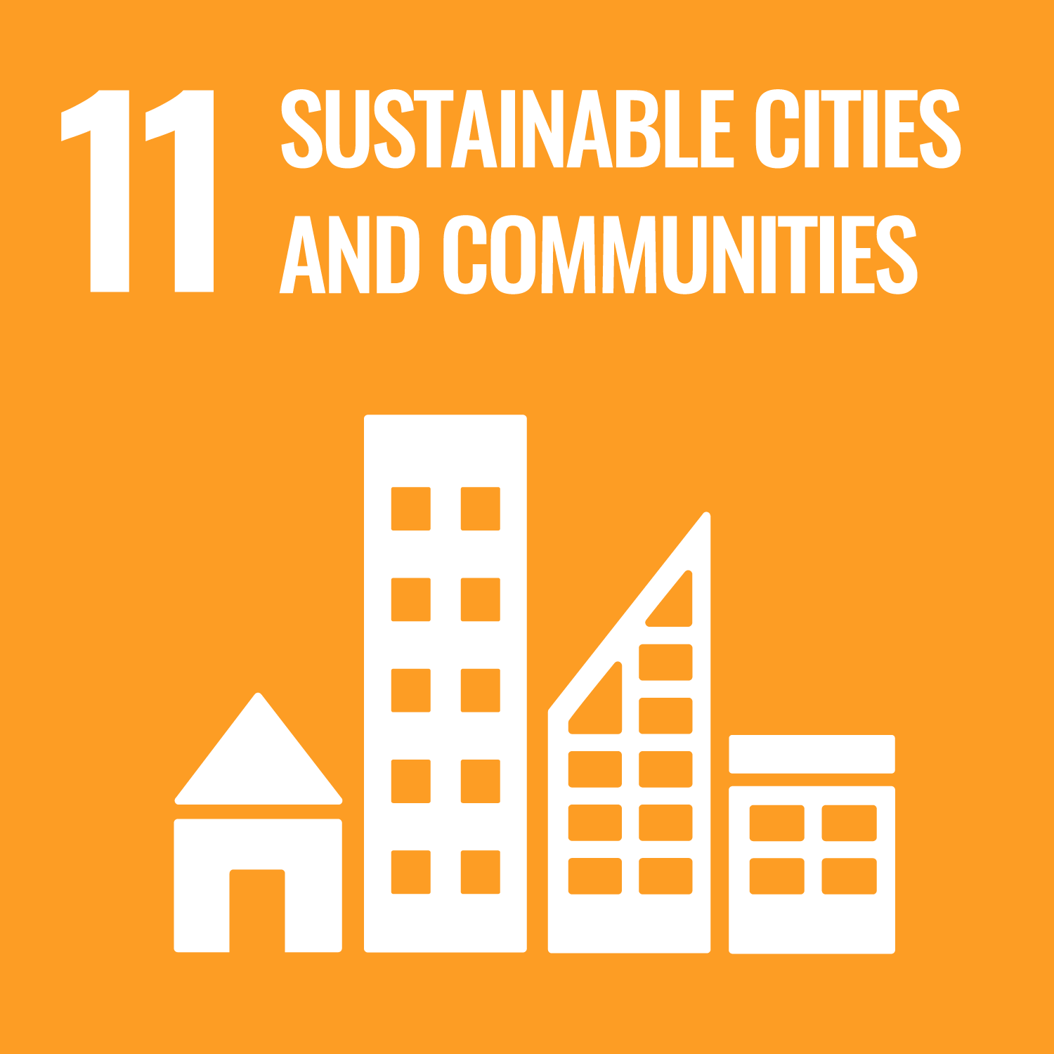
SDG 11: Sustainable Cities and Communities
"Make cities and human settlements inclusive, safe, resilient and sustainable.”
SDG 11 - SDG 11 aims to renew and plan cities and other human settlements in a way that offers opportunities for all, with access to basic services, energy, housing, transportation, and green public spaces, while reducing resource use and environmental impact.
In the EU context, monitoring SDG 11 means looking at developments in the quality of life in cities and communities, sustainable mobility and adverse environmental impacts.

Slide 12
The Core Targets of SDG 11
SDG 11 is broken down into ten specific targets that address the physical, social, and environmental fabric of urban life:
11.1 Housing and Slums: By 2030, ensure access for all to adequate, safe, and affordable housing and basic services and upgrade slums.
11.2 Sustainable Transport: Provide access to safe, affordable, accessible, and sustainable transport systems for all, notably by expanding public transport.
11.3 Participatory Planning: Enhance inclusive and sustainable urbanization and capacity for participatory, integrated, and sustainable human settlement planning.
11.4 Cultural and Natural Heritage: Strengthen efforts to protect and safeguard the world’s cultural and natural heritage.
11.5 Disaster Resilience: Significantly reduce the number of deaths and the number of people affected by disasters, with a focus on protecting the poor.

Slide 13
11.6 Environmental Impact of Cities: Reduce the adverse per capita environmental impact of cities, including air quality and waste management.
11.7 Green and Public Spaces: Provide universal access to safe, inclusive, and accessible, green, and public spaces.
11.a Support positive economic, social and environmental links between urban, peri-urban and rural areas by strengthening national and regional development planning.
11.b By 2020, substantially increase the number of cities and human settlements adopting and implementing integrated policies and plans towards inclusion, resource efficiency, mitigation and adaptation to climate change, resilience to disasters, and develop and implement, in line with the Sendai Framework for Disaster Risk Reduction 2015-2030, holistic disaster risk management at all levels.
11.c Support least developed countries, including through financial and technical assistance, in building sustainable and resilient buildings utilizing local materials.

Slide 14
What makes a settlement sustainable?
Smart cities are committed to systemic sustainability, transform energy systems and devise mobility options to counteract climate change, offering optimal quality of life to their citizens with minimum use of resources; additionally, engaging their inhabitants in co-developing new business models in support of the transition to energy-efficiency and a circular economy.
Urban resilience is the ability of urban systems to maintain stability during stress and the flexibility to adapt to changing conditions.
We need to build more resilient systems and infrastructures in our communities to prepare for more frequent natural disasters as a result of the climate crises and possible future public health challenges, such as pandemics.

Slide 15
Potential Contribution by Municipalities
The purpose of municipalities is to plan, manage, and improve public work and services to the community. There is no more important SDG than this one for the work of and for the city.
The tasks for municipalities for SDG 11 are manifold and encompass the social, the ecological, and the economic dynamics of systemic sustainability.
We need to work together and support each other in order to make our cities and communities healthy, safe and regenerative!

